Slide 1
Machine learning Mini-project: Weighted KNN
Menglin Xi
Carl-Friedrich-Gauß-Fakultät Mathematik

Slide 2
Catalog
1. Data Set
2. What is WKNN?
3. Weighted functions
4. Distance conditions
5. An Example
6. Compare WKNN vs KNN
7. Code and result

Slide 3
About my Dataset: Iris and Avocado Price
Which library ?
import numpy as np
import random
import matplotlib.pyplot as plt
from collections import Counter
from sklearn.datasets import load_iris
from sklearn.model_selection import train_test_split
from sklearn.preprocessing import StandardScaler
Dataset Iris: sklearn link
Dataset Avocado Price: Kaggle link
Dataset | Training Set | Testing Set
Iris | 120 Samples | 30 Samples
Avocado | 14599 samples | 3650 Samples
Training Set : Testing Set = 4 : 1

Slide 4
What is weighted KNN ?
In KNN：
when we find the K nearest neighbors of the observation point(x,y) and get the targets of these K points, we take the target with the highest frequency as the result of the new observation(x, y).
This means that the K nearest points we choose have equal influence on the classification results of the new observation(x, y).
In weighted KNN:
We want the K nearest points have different influence with decision, which are particularly close to the new observation(x, y) , should get a higher weight in the decision than such neighbors that are far away from (x, y).
So what is the relationship between weight and distance?
Which function can be used?

Slide 5

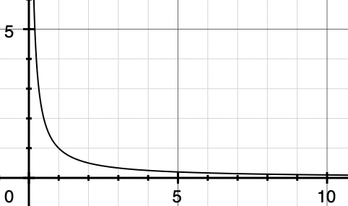
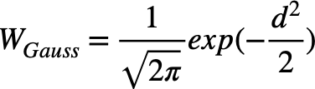
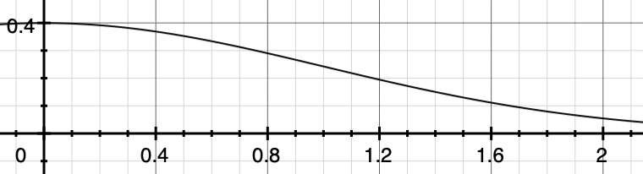

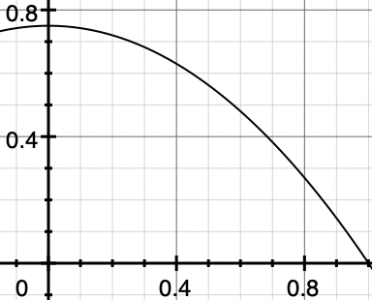
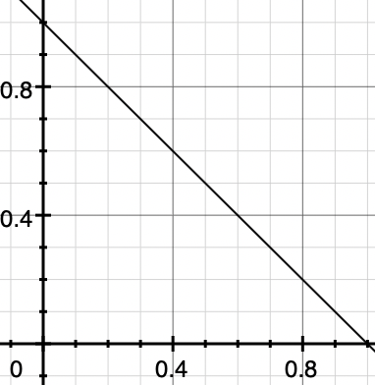

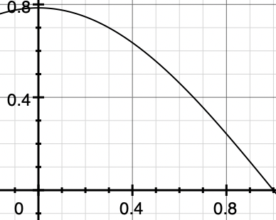

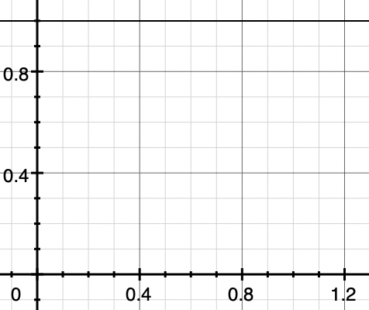
Weight Functions
inversion kernel |  | Gauss kernel
Epanechnikov kernel |  | triangular kernel
Cosine kernel |  | mean_one kernel
The smaller the distance, the greater the weight
Just choose one you like(1-5).
The last one is just like normal KNN.

Slide 6
Distance condition
1. We use Euclidean distance
2. For inversion kernel, the distance cannot be 0
3. For W_triangular, W_Epanechnikov, and W_cosine, the |d| <= 1, how can we make it ?
We can use the distance of the (k+1)th nearest point as the divisor
$$d=\frac{d_{i}}{d_{k+1}},i=1,2,...,k$$

Slide 7
An example
Classification
KNN | 1 | 1 | 1 | 1 | 1 | 1
Target | A | B | B | C | A | A
wKNN | 0.90 | 0.88 | 0.84 | 0.77 | 0.46 | 0.30
sum_knn | 3 | 2 | 1
Target | A | B | C
sum_wknn | 1.66 | 1.72 | 0.77
Regression
A,B,C are float price
KNN | WKNN
$$y=\frac{3A+2B+C}{6}=\frac{A}{2}+\frac{B}{3}+\frac{C}{6}$$
$$y=\frac{1.66A+1.72B+0.77C}{1.66+1.72+0.77}=\frac{2A}{5}+\frac{166B}{415}+\frac{77C}{415}$$

Slide 8
Compare KNN and weighted KNN
Advantages of WKNN vs KNN
Consider the influence of distance on the decision
Different weight functions can better adapt to different data sets
Reduce the distraction of relatively distant points
Expect to achieve better results
Disadvantages of WKNN vs KNN
Weight functions take more time to calculate
Very weak immunity to nearby points
WKNN is inefficient
When to use WKNN
Data set is small
You have enough time and interest
When to not use WKNN
Data set is large
Data is very dense or very sparse
Not useful in Iris Dataset

Slide 9
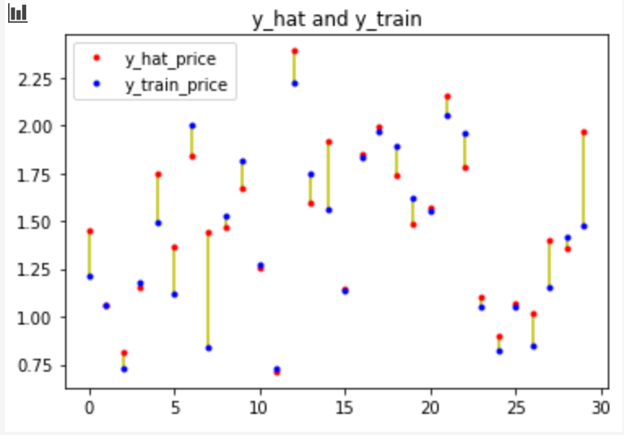
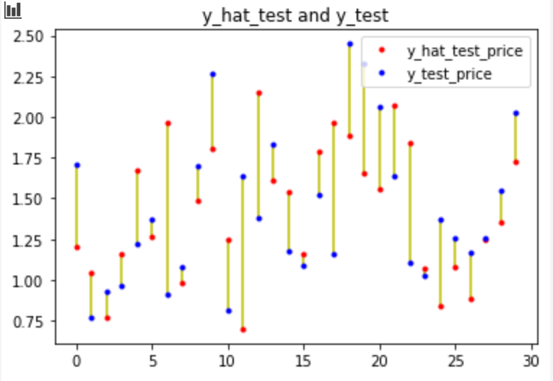
Show some codes and results: Avocado Price
[1036.74 54454.85 48.16 8696.87 8603.62 93.25 0.0 ‘conventional' 'Albany''2015-12-27']
[1036.74 54454.85 48.16 8696.87 8603.62 93.25 0.0 0 0 51]
The effect of regression price looks very bad, and the effect of converting time, region, and type into float values is not good enough.

Slide 10
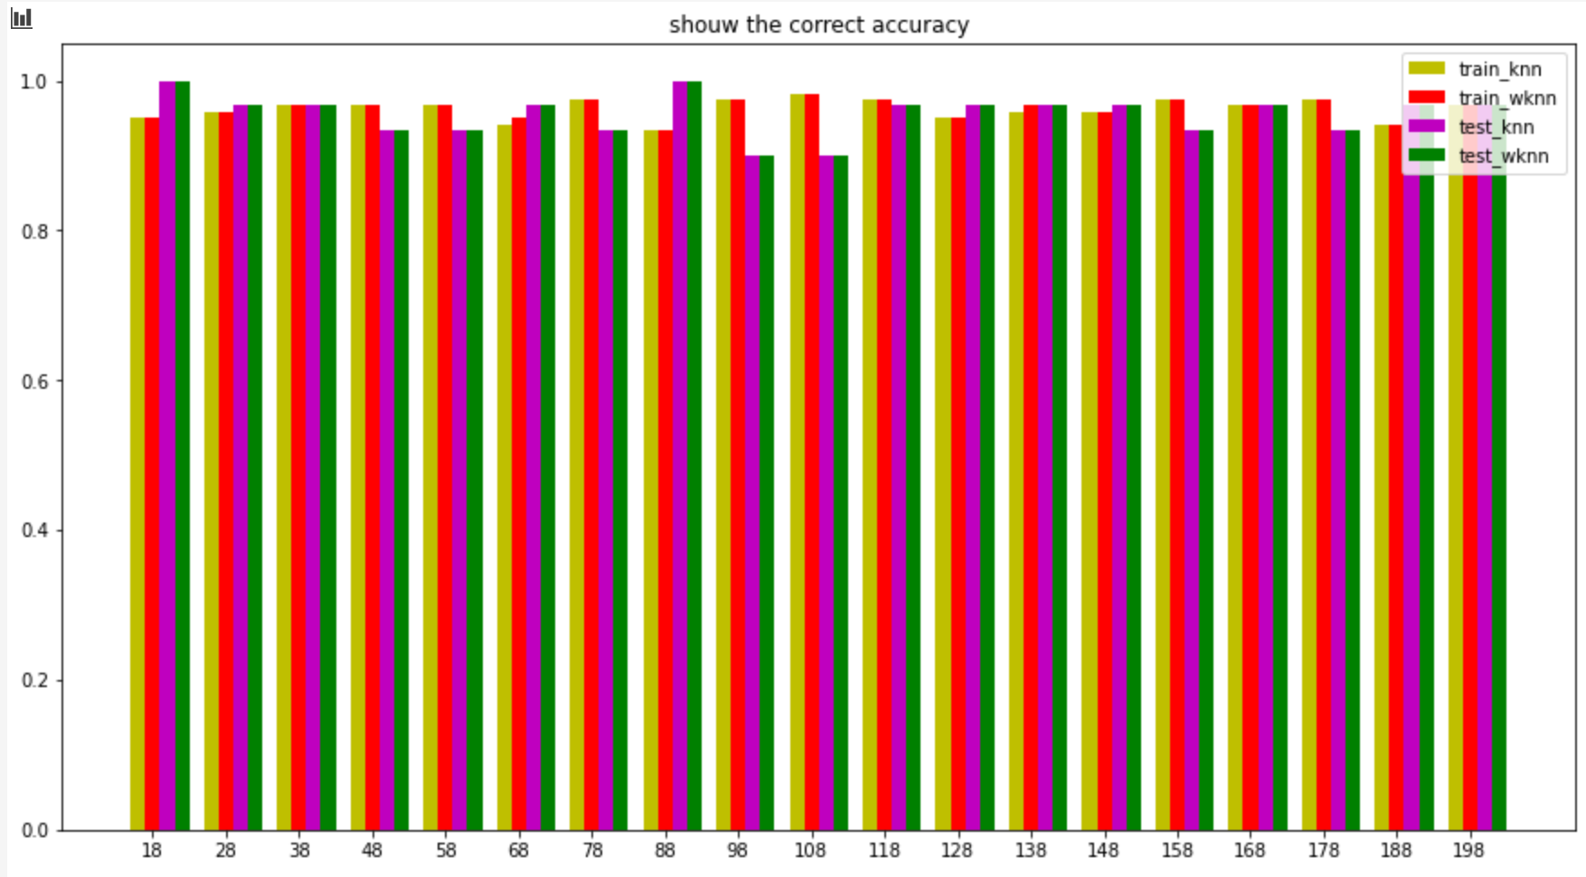
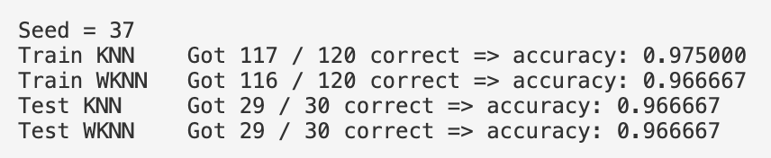
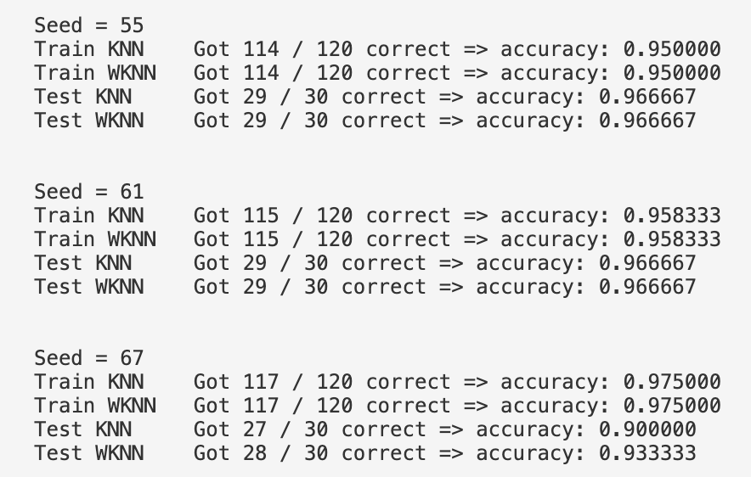
Show some codes and results: Iris
In general, wknn has a little optimization effect, but the effect is not obvious. Increasing the data set may improve accuracy, but it takes longer.

Slide 11
References
All the pictures and tables are completed by myself.
I am happy to share my code and ppt with you.
Page 2, I give theta sets links, you can check it later.

